Slide 1
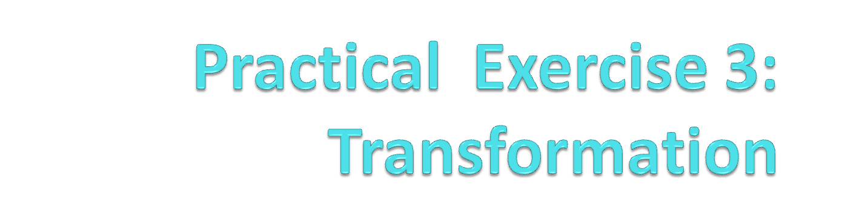
BACS 2173 Graphic Programming
[TOTAL : 20 marks]

Slide 2

Exercise Q2
Today, we go…

Slide 3
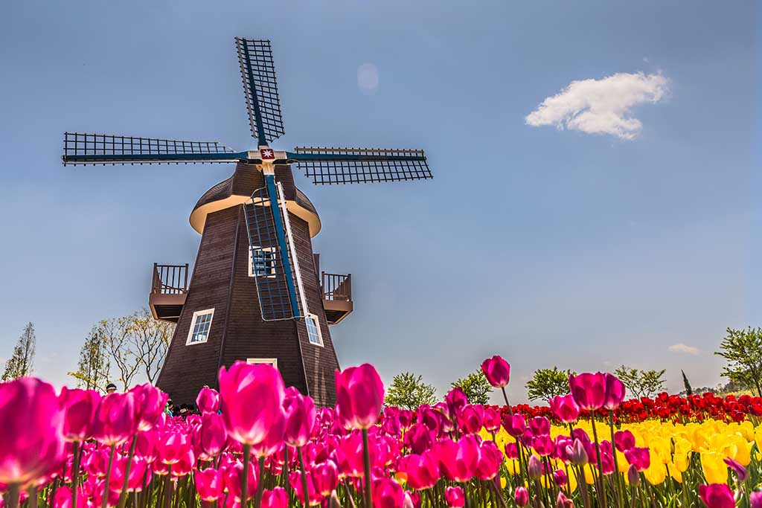
Exercise Q2
What famous is Netherlands?

Slide 4
Exercise Q2
By using all the primitives you have learn before, create a windmill that fulfill the following requirements :
  Spinning clockwise and anti clockwise.
  Accelerate and decelerate the speed of the spinning.
  Stop the spinning.
  (17 marks)

Slide 5
Exercise Q2
Criterias | Marks
Creativity | 2
Complexity of graphic | 5
Requirements | 6
Background | 2
Extra features | 2
TOTAL | 17

